Slide 1
Fishery Waste Management
Advanced Course For Postgraduate Students
2021-2022

Slide 2
Introduction
Important Definitions:
Fishery VS Fish
Fishery (PL. Fisheries): A place or geographical location where fish and other aquatic organisms are caught, cultured or handled.
Fish: The known aquatic animals.

Slide 3
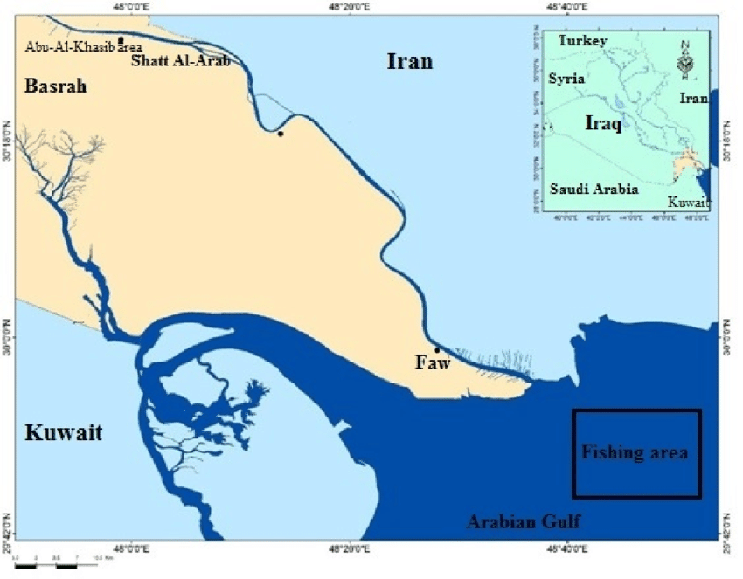
Marine Fisheries of Iraq

Slide 4
Fisheries VS Fish Wastes
Fisheries wastes include many fish species or by-catch products having no or low commercial value, undersized or damaged commercial species as well as species of commercial value but not caught in sufficient amounts to warrant sale.
Fish wastes may include, but is not limited to, particles of flesh, skin, bones, entrails, shells or liquid stick water.

Slide 5
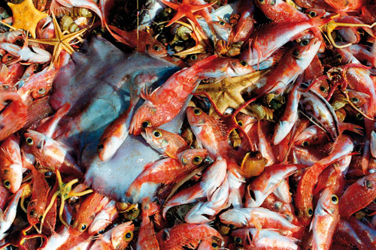
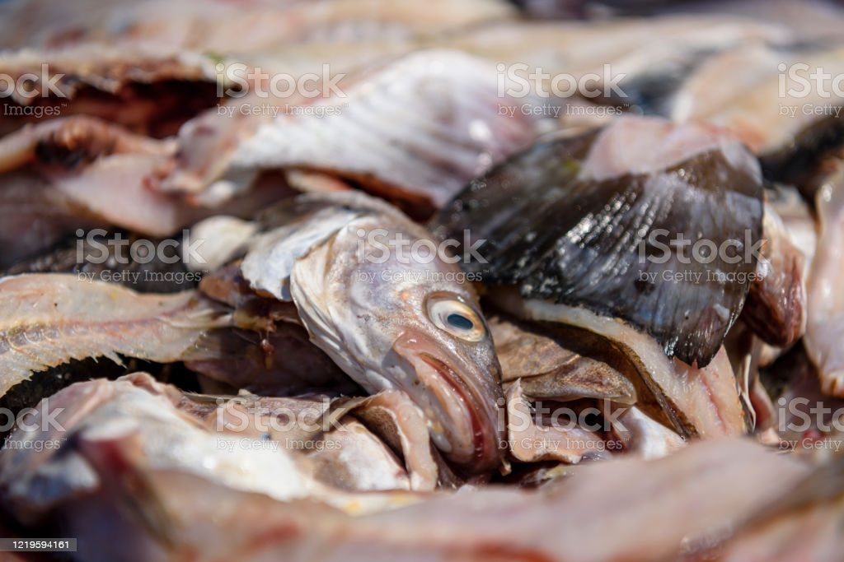
Fisheries VS Fish Wastes

Slide 6
Waste Management
Waste management is defined as the actions or methods of monitoring, allocation, collection, transport, processing and recycling or disposal of waste materials.
Waste recycling (or disposal) is to pass a substance through a system that enables that substance to be reused.
It involves the collection of waste materials and the separation and clean-up of those materials. Recycling waste means that fewer new products and consumables need to be produced, saving raw materials and reducing energy consumption.

Slide 7
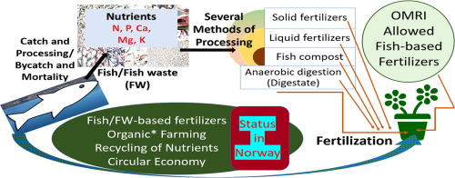
Recycling fish wastes into fertilizers

Slide 8
Problem of Fish Wastes
Fish wastes degrade rapidly in warm temperatures. If not appropriately stored or managed, fish wastes create aesthetic problems and strong odors as a result of bacterial decomposition. The organic components of the waste have a high biological oxygen demand and, if not managed properly, high oxygen demand poses environmental and health problems.

Slide 9
Environmental Risks of Fish Wastes
Some fish wastes are transported for disposal at natural water bodies. Environmental concerns associated with disposal of fish wastes into water bodies include:
1- reduced oxygen levels in the water especially at the bottom;
2- burial or smothering of living organisms; and
3- introduction of disease or non-native and invasive species to the aquatic ecosystem.

Slide 10
Economic Importance of Fish Wastes
Fish wastes may contain a variety of important nutrients such as proteins, lipids and other components which could be used in expanded aquaculture as feedstuffs.
Many other components of fish wastes like omega 3 PUFA could be used in human nutrition as well as many pharmaceutical and cosmetic industries.
Recycling of fish wastes could be economically profitabl as well as eco- friendly activity.

Slide 11
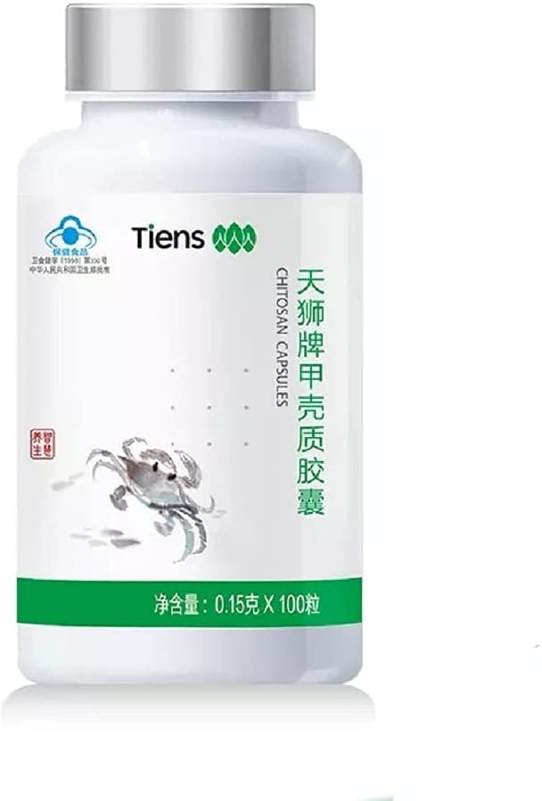
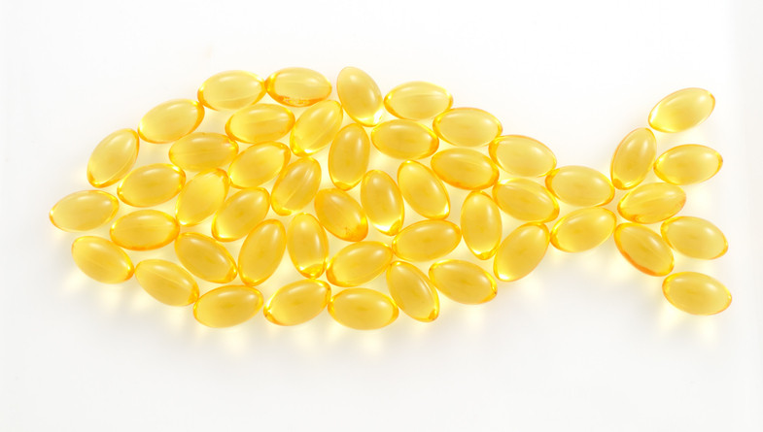
Fish Oil and Crab Chitosan

